Slide 1
Global Currency Forecaster
Team Members:
Jhansi Lakshmi Lakkireddy
Sri Sai Sindhu Penmetsa
Priyanka Valisetti
Naman Tenguria
Tarun Venkat Sai Narayanam

Slide 2
Introduction
Problem Overview
  Goal: Accurately predict USD to INR exchange rates.
  Importance: Essential for international business, investment strategies, and economic policies.
Our Approach
  Techniques: Decision Tree Regressor, Multilayer Perceptron (MLP), and Prophet Model.
  Advantages: Captures complex patterns, improves with new data, and enhances accuracy.
Benefits
  Economic Strategy: Better informed decisions for stability and growth.
  Financial Planning: Increased profitability and reduced risk.
Impact
  Transforms currency predictions into a reliable, data-driven practice.
Visuals:
Graphs of model predictions vs. actual rates.
Icons for technology, global trade, and analytics.

Slide 3
Data Collection
Data Source
  Provider: TraderMade API
  Coverage Period: May 29, 2023, to April 29, 2024
  Currency Pair: USD to INR
Key Features of the Dataset
  Date: Tracks daily exchange rate data for temporal analysis.
  Open Rate: Opening rate of USD to INR each day.
  High Rate: Peak exchange rate within each trading day.
  Low Rate: Lowest exchange rate observed each day.
  Close Rate: Closing rate of USD to INR each day.
Purpose of Data Collection
  To understand historical exchange rate fluctuations.
  Identify patterns and trends influencing future rates.
Importance for Predictive Modeling
  Provides a robust foundation for developing accurate predictive models.
  Enhances model reliability by including detailed daily exchange movements.

Slide 4
Data Exploration
Objective of EDA
  To uncover insights into the dynamics of USD to INR exchange rates through visual analysis.
Visualization Techniques Used
  Candlestick Charts: Visualize daily fluctuations, highlight trends, and potential reversal points.
  Line Plots: Show overall trend and significant fluctuations over time using closing rates.
  Correlation Matrices: Analyze relationships between open, high, low, and close rates to identify dependencies.
Key Findings from EDA
  Identification of clear trends and seasonal patterns.
  Insights into daily price volatility and trading patterns.
  Strong correlations between different aspects of exchange rate data, guiding predictive modeling.
Impact on Model Development
  Informed the selection of appropriate modeling techniques.
  Provided a solid foundation for robust predictive analysis.

Slide 5
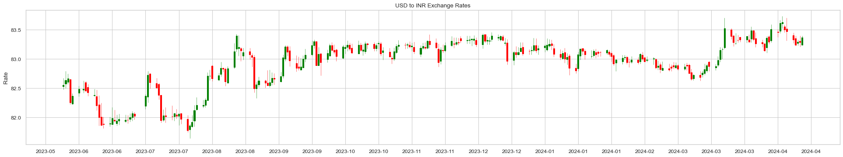
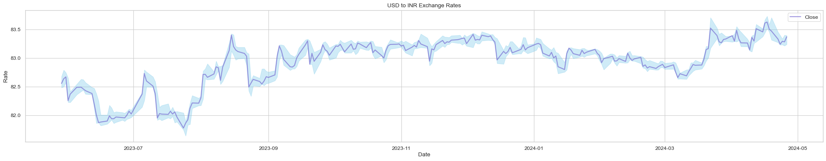
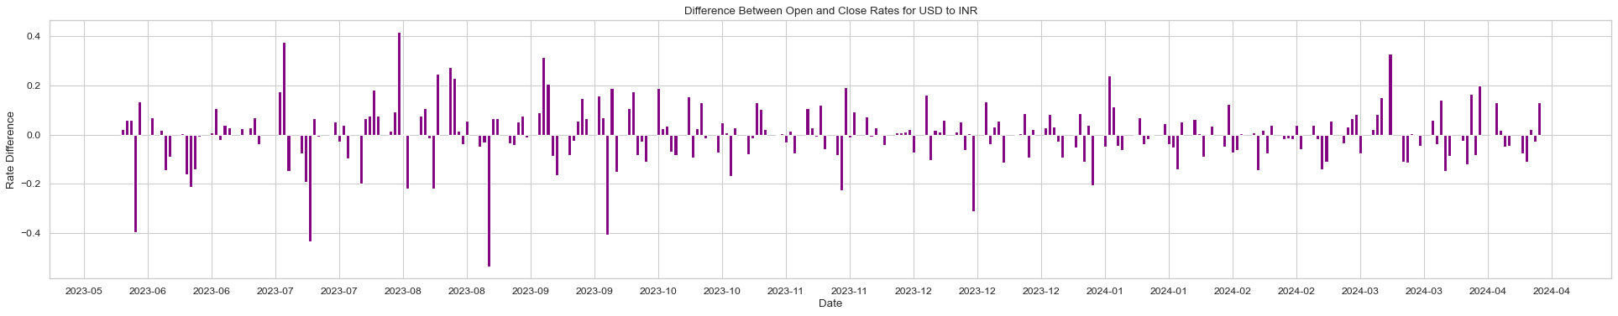
Visual Elements
Candlestick Chart, Line Plots :

Slide 6
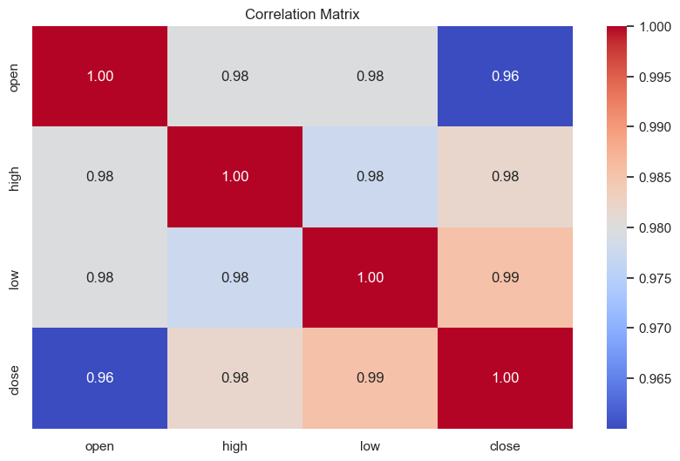
Visual Elements
Correlation Matrix:

Slide 7
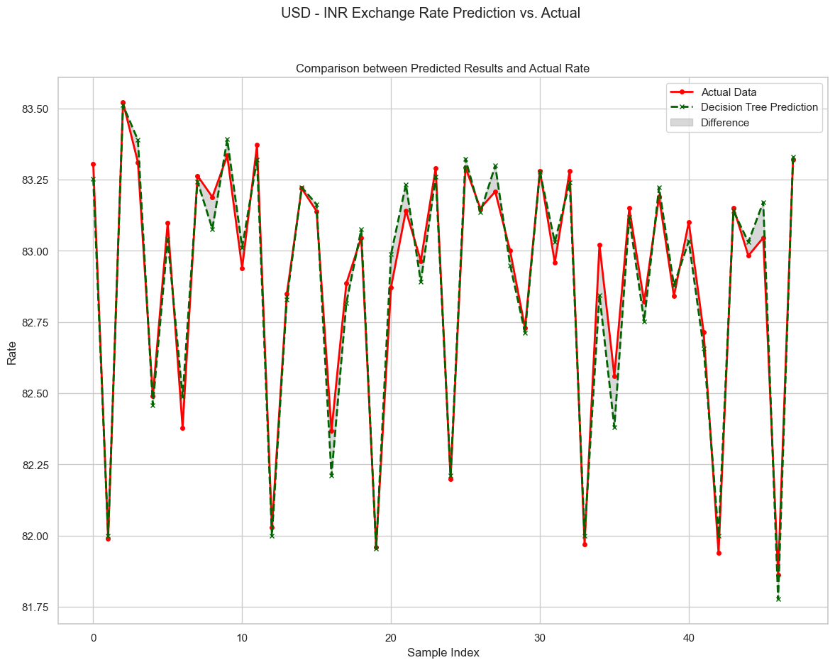
Data Analysis
Decision Tree Regression Model

Slide 8
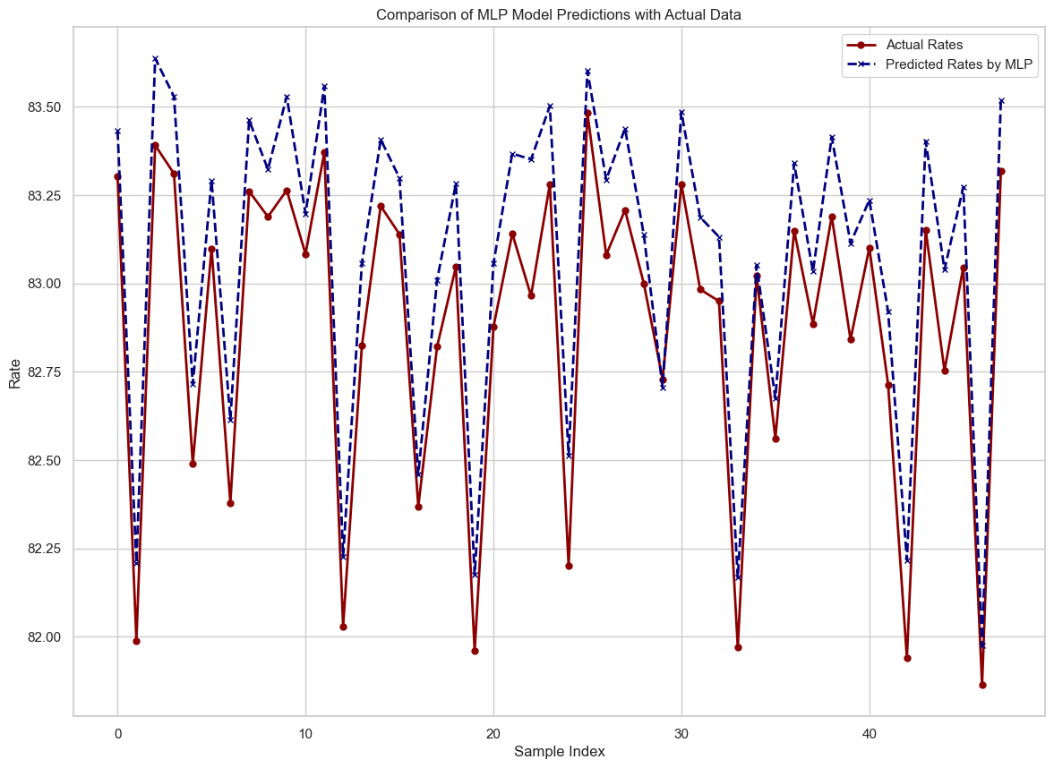
Data Analysis
2. MLP (Multilayer Perceptron) Layer

Slide 9
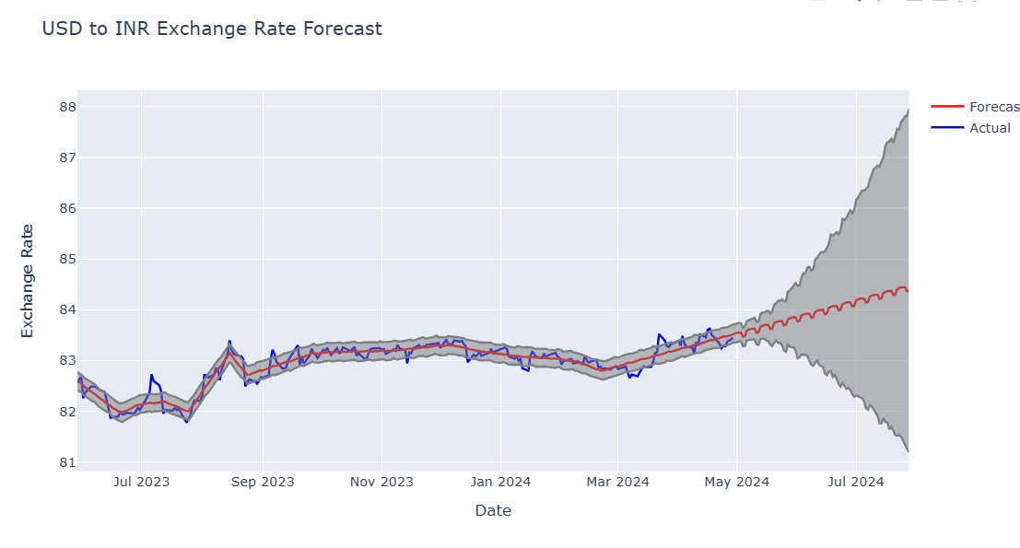
Data Analysis
3. Prophet Model

Slide 10
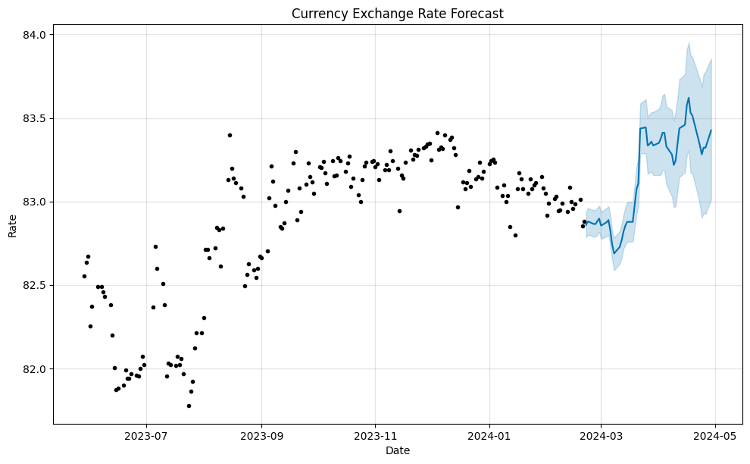
Results

Slide 11
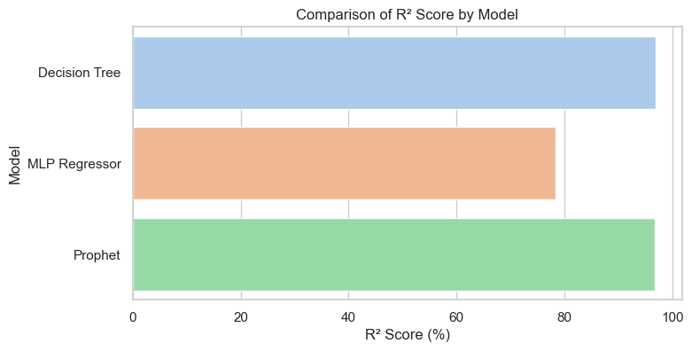
Comparisons

Slide 12
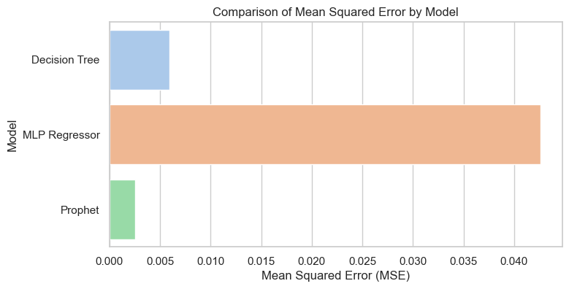
Comparisons

Slide 13
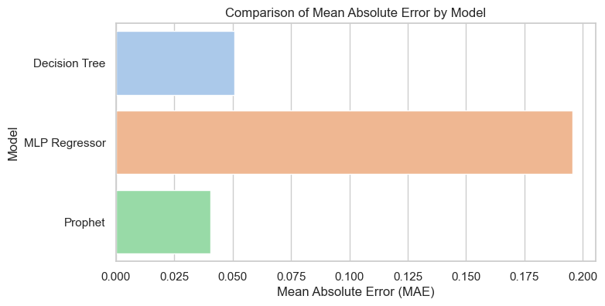
Comparisons

Slide 14
Conclusion
The analysis underscores the Prophet model as the standout performer, achieving the highest accuracy with the lowest error rates among the examined models. Its ability to provide confidence intervals adds significant value by quantifying forecast uncertainty, a critical feature for stakeholders in volatile financial markets.
The use of advanced forecasting models like Prophet is crucial for effectively managing economic risks associated with fluctuating currency rates. Continuous model evaluation and data analysis are essential to adapt to changing market dynamics, ensuring that forecasts remain relevant and accurate. This approach empowers stakeholders to make informed, strategic decisions, enhancing economic and financial planning.

Slide 15


